Slide 1
Adaptive Cards
Adaptive Cards & Actionable Messages

Slide 2

Adaptive Cards & Actionable Messages
Adaptive Card Overview
Card Reference and Visualizer
Actionable Messages with Adaptive Cards

Slide 3

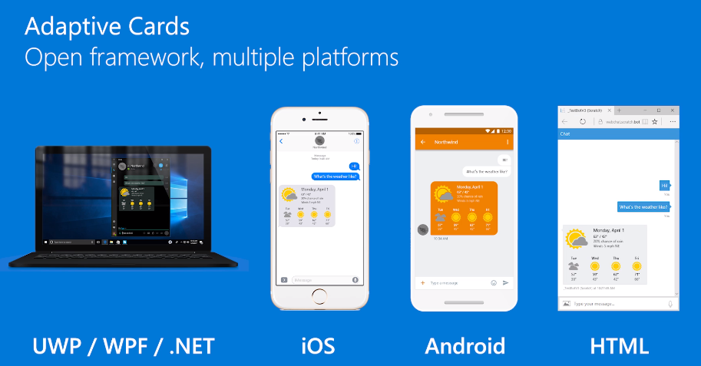
Adaptive Cards
https://adaptivecards.io
Notes:
Use the MessageCard Playground to view samples and design your own cards

Slide 4
Adaptive Cards
Goals
Portable - To any app, device, and UI framework
Open - Libraries and schema are open source and shared
Low cost - Easy to define, easy to consume
Expressive - Targeted at the long tail of content that developers want to produce
Purely declarative - No code is needed or allowed
Automatically styled - To the Host application UX and brand guidelines

Slide 5
Adaptive Card schema
Property | Examples
Cards | Adaptive Cards
Card Elements | TextBlock, Image
Containers | ColumnSet, FactSet, ImageSet
Actions | OpenUrl, Submit, ShowCard
Inputs | Text, Number, Date/Time, Toggle, Choice
Notes:
All text fields in the card support markdown.

Slide 6
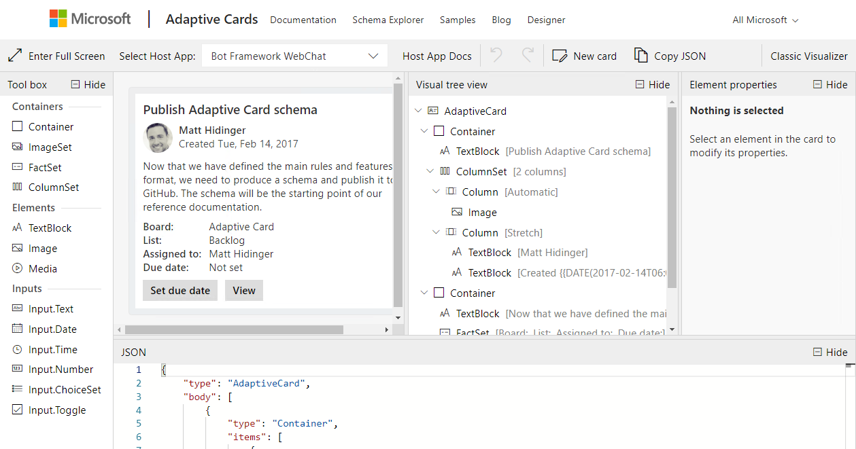
Adaptive Card Designer
https://adaptivecards.io/designer
Notes:
Use the Adaptive Card Designer to create and view samples in the various host applications (from Microsoft)

Slide 7

Actionable Messages with Adaptive Cards
You can send actionable messages to yourself using the Office 365 SMTP server or the Microsoft Graph. You will be unable to send actionable messages to any other user until you have registered using the actionable messages developer dashboard.
Set hideOriginalBody property
The message body should be added, but hidden if the card contains all the information the user needs. Body is shown if host does not support cards.
Cards are not included in replies or forwards of email.
Card (json) is wrapped in <script>
Script tag must have type:
application/adaptivecard+json
<script> is added to <head>
Message body is an HTML document.
Adaptive card is in <head> element.
Message body is in <body> of document.

Slide 8
Sender Verification for Actionable Messages with Adaptive Cards
Office 365 requires sender verification in order to enable actionable messages via email.
Implementing DKIM and SPF
DKIM and SPF are industry standard ways to prove a sender's identity when sending emails over SMTP. Many companies already implement these standards to secure the emails they are already sending.
Signed card payloads
SPF/DKIM failure caused by sender setup or recipient tenant set custom security services in front of Office 365 services.
Your scenario for actionable messages requires sending from multiple email accounts..
Message body contains a payload in Microdata format that is encoded in a JSON Web signature.

Slide 9
Demo

Slide 10

Summary

Slide 11
Thank you

